Slide 1
SteemChess
By: Alex Boyle, Nisarg Brahmbhatt, Warren Devonshire, Matthew Halloran, Daniel Haluszka, Michael Naples and Troy Pastirko

Slide 2
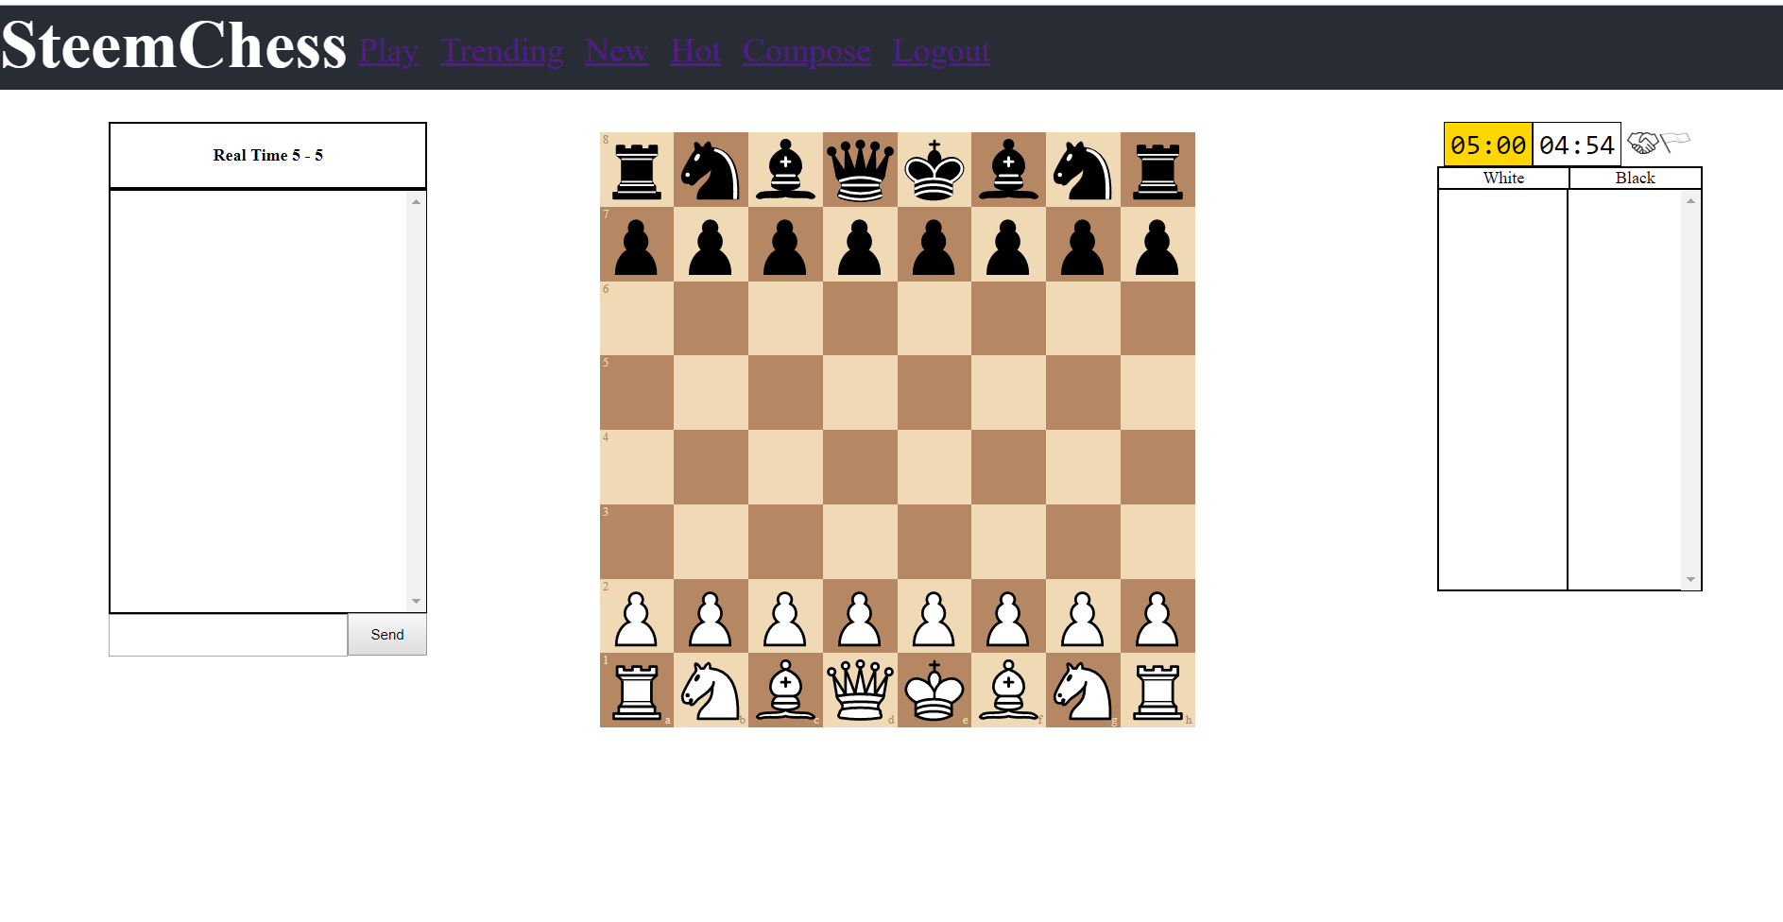
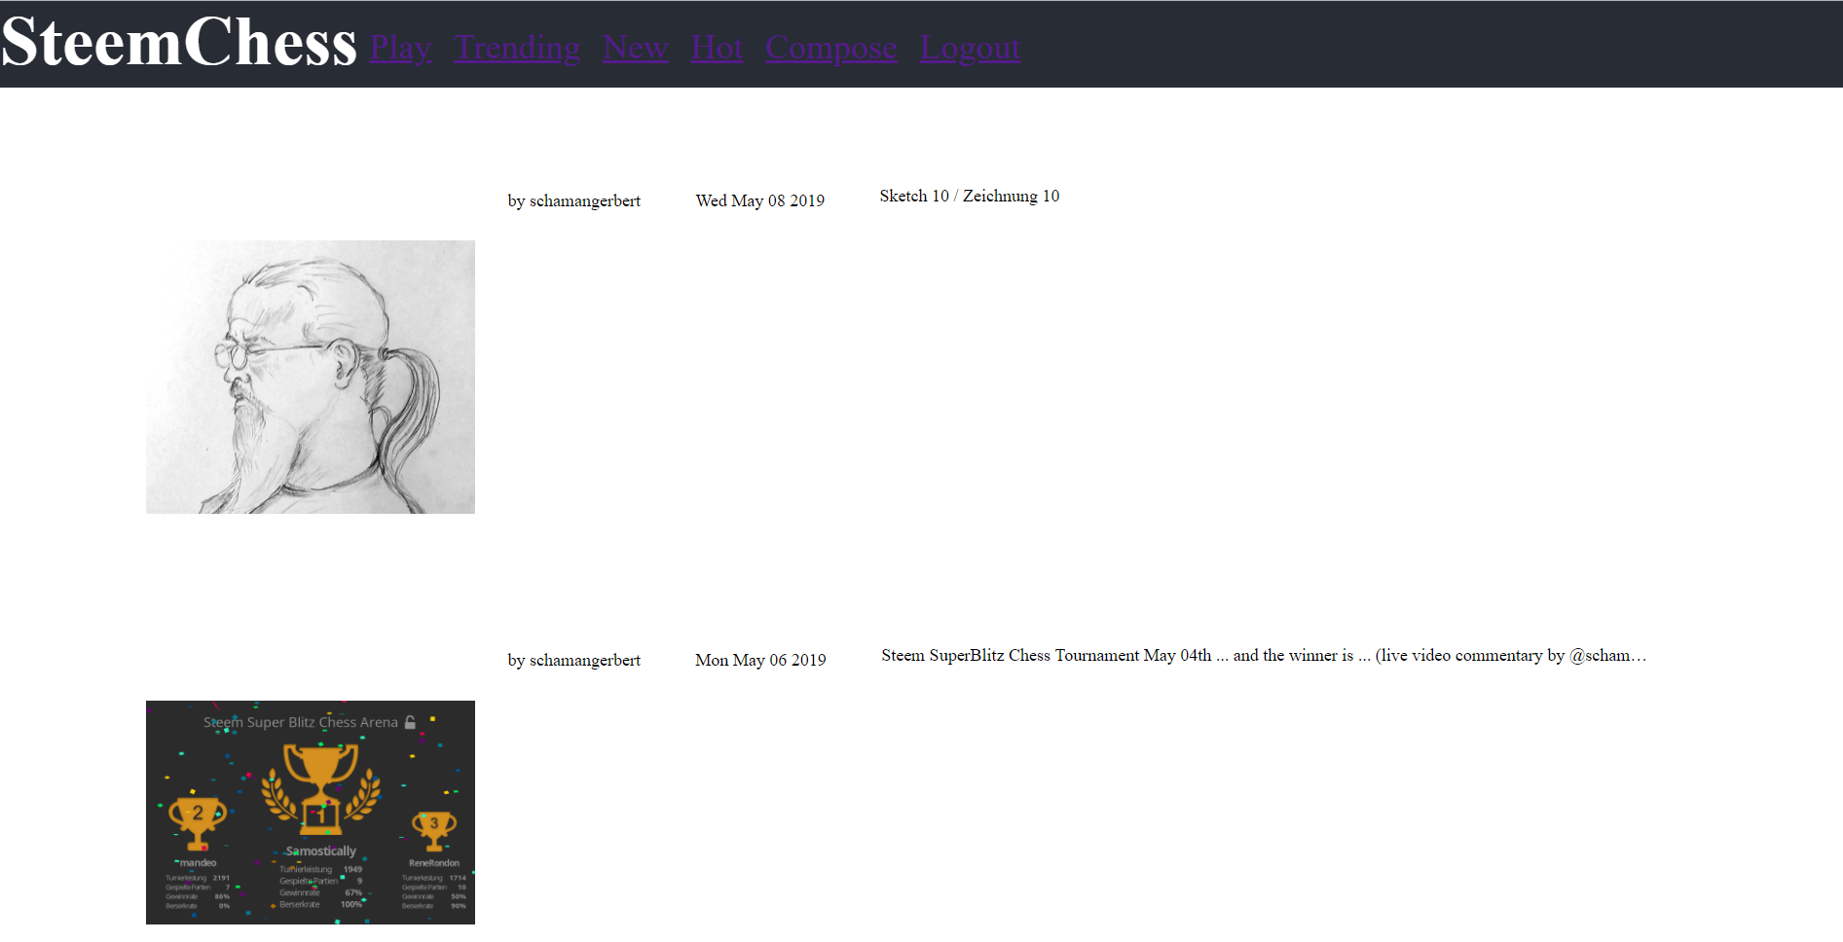
What is SteemChess
It’s chess but using blockchain for matchmaking
It’s a chess themed blogging site similar to reddit

Slide 3
Our Motivation Behind SteemChess
We wanted to do something with the blockchain
We thought we could create something useful without having to invest in a traditional backend server.

Slide 4
Tech Stack
html/css/javascript
react.js
dsteem.js
WebRTC
chess.js / chessboardjsx

Slide 5
Blockchain Concept
Public
Anyone can access all information on the blockchain
Decentralized
Maintained and validated by every user
Immutable
Blocks cannot be changed once added to the blockchain
Serves as the basis for cryptocurrency
User contribution can be measured and rewarded accordingly
Steem blockchain revolves around user contribution via social media
Level of contribution is determined by votes of other users
Encourages meaningful and constructive contributions by users
Allows for higher traceability and accountability of user actions
Notes:
Blockchain acts as alternative to the traditional centralized server approach.
Information can be accessed and used by anyone in a variety of ways.
Information is stored in a collection of “blocks,” a copy of which exists for each user of the blockchain.
Because it is decentralized, fraudulent changes cannot be made without updating the blockchain for every user.
In the case of a conflict, resolution happens through means of community consensus.
Censorship-resistant: Access to info on the blockchain cannot be restricted without cutting off communication with every user of the blockchain.
Steem blockchain was designed to serve as a framework for social media sites.
Offers many benefits on this front when compared to a traditional centralized server approach, more on that later.

Slide 6
Newest Block
Blockchain Illustration
Block n
Block 4
Block info: Time stamp, # of transactions, etc...
Transaction:
Author
Data
Etc…
Signed and added to the blockchain
Block n-1
Block 3
Block 2
Oldest Block
Block 1
Notes:
Blockchain is an iterative structure; Newest blocks are added “on top of” older blocks to create the chain.
Transactions are recorded and added to current block, each block can contain information about many different kinds of transactions.
Steem blockchain is built to handle social media transactions as well as custom JSON.

Slide 7
Creating and Signing Blocks
Block production on the Steem blockchain is done in rounds
Steem schedules witnesses to produce blocks every 3 seconds
21 witnesses are selected to create and sign blocks of transactions
Twenty (20) of these witnesses are selected by approval voting and one is timeshared by every witness that didn’t make it into the top 20 proportional to their total votes
Witness selection is based off of community reputation and contributions which is measured through SteemPower (or voting power)
Censorship resistant
Abuse results in removal from power

Slide 8
Data Flow
Blockchain
Centralized Server
Copy of Blockchain
Copy of Blockchain
Copy of Blockchain
SteemChess Server
SteemChess Website
SteemChess Website
Site User
Site User
Site User
Site User
Notes:
Blockchain:
Users interface with the website to access and post information.
Users can also interface directly with the blockchain to view relevant information.
Copy of blockchain could be another user, another website, etc.
Website interfaces with blockchain for vital information. Very little is stored on the website itself.
Server:
Users only interface with website, no access to data otherwise.
Website interfaces with backend server for vital information. All information is stored on server.

Slide 9
Pros and Cons
Blockchain
Centralized Server
Pros:
No need to host information
No centralized target for attacks
Match negotiation and results are publically available to view, easy verification for users
Simple access to all other chess content on blockchain
Built-in rewards for content creation
Cons:
May be subject to delays during periods of heavy blockchain traffic
Reliability and uptime of blockchain cannot be guaranteed
Sensitive data must be well-encrypted in order to be posted to blockchain
Fewer backend design choices
Pros:
Easy access to data for server owner, no blockchain API needed
More choices available for website backend design
Easier to control uptime and reliability
Cons:
Must host information
Responsible for server upkeep
Subject to security threats if server is not well-secured
Data cannot be accessed through means other than the website
Data can be altered by anyone with access to server, leading to integrity threats

Slide 10
Matchmaking Protocol
Post Game Request
Receive Join Request
Create SDP Offer
Accept SDP Answer
Send Close Signal
Player 1
Steem
steem-chess-post-game
steem-chess-request-join
steem-chess-signal-i
steem-chess-signal-ni
steem-chess-request-closed
Find Game Request
Request to Join
Accept SDP Offer
Post SDP Answer
Player 2

Slide 11
Matchmaking: An In-Depth Look
Locating blocks
Find most recent block number found through dsteem
Open a stream from that number or earlier
Check blocks for correct tag
Finding game requests
Searches blocks for compatible game data, such as:
Request was created less than 5 minutes ago
Request was not closed
Time and increments match
Starting colors are opposite, or one is “random”
Blockchain encryption
All blocks are public, so encryption is needed for creating P2P connection
Players both create a public/private key pair
Public keys are sent through create and join requests

Slide 12
Matchmaking: Pros and Cons
Pros
Blocks publicly visible
Players could easily connect across different chess websites (such as an app)
Users can see what data is exposed
Connection is peer-to-peer
Once connected, players can securely send data to each other without going through the blockchain or a database
Cons
Streams include all blocks, not just from SteemChess
High blockchain activity could cause slow performance
Limited Steem bandwitdh
Players with few resource credits can be temporarily locked out after enough matches

